Slide 1

Developing a credit risk score card for NBFC companies in India Using Financial Ratios
Project Guide:
Mr. Kingshuk Roy
Mr. Puneet Gupta Ms. Goldy Bajaj
Project by:
Balam Sravan Krishna Kumar

Slide 2

Project analysis slide 3
Prerequisites
Credit Risk
Scorecard models
FINANCIAL ANALYSIS
Application Scorecard
Behavioral Scorecard
Collection Scorecard
We were aiming to create a Financial Risk Scorecard, which is a type of Application Scorecard.
In order to build credit risk model we need to study the key financial ratios which defines the credit risk for companies
Credit Score is a numerical value that represents the credit worthiness of an individual.

Slide 3


Project milestones
Data Collection process
Data Cleaning and transformation
EDA
Model building
Model Validation

Slide 4
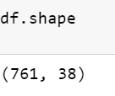
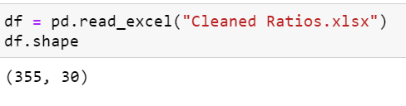
Data collection
The very first step of the project was collection of data. This process was carried out and data, in this case the Financial Ratios of the NBFCs.
The data was collected from sources like Bloomberg and Money Control. We collected data of NBFC companies in India for 5 years as that would provide an abundant amount of data for analysis.
Data Cleaning
The data was then cleaned as there were a lot of null values present within the dataset.
After Cleaning
Before Cleaning

Slide 5
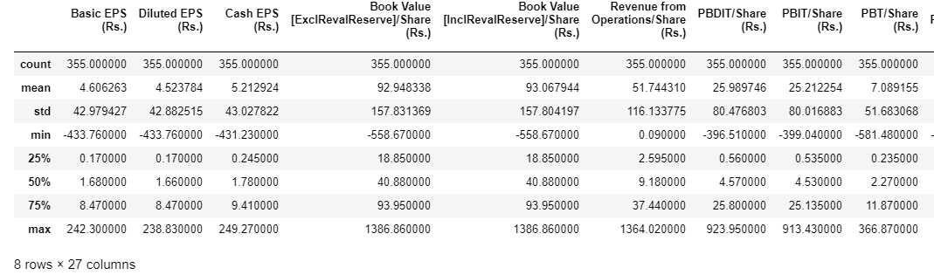
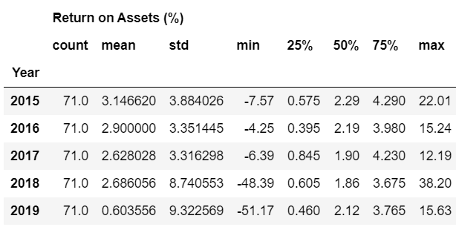
Exploratory Data Analysis
Data Summary
We had done analysis of summary statistics of all the variables
We also found year wise descriptive statistics of Interest coverage ratio to find out the min max values to categorize variable
Year wise Summary ICR

Slide 6
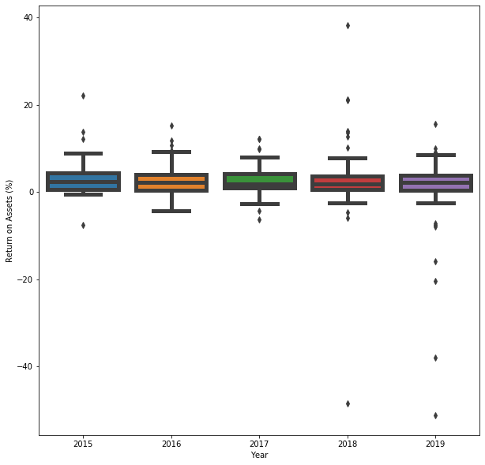
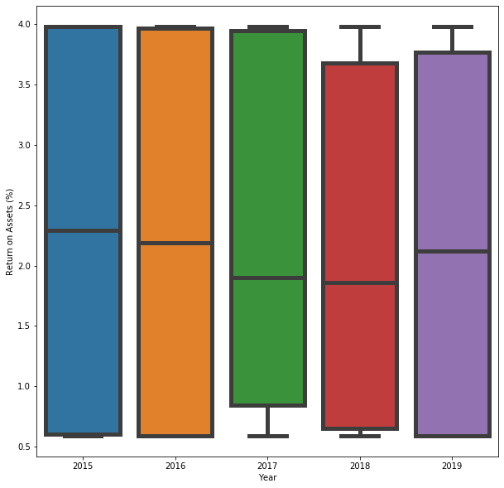
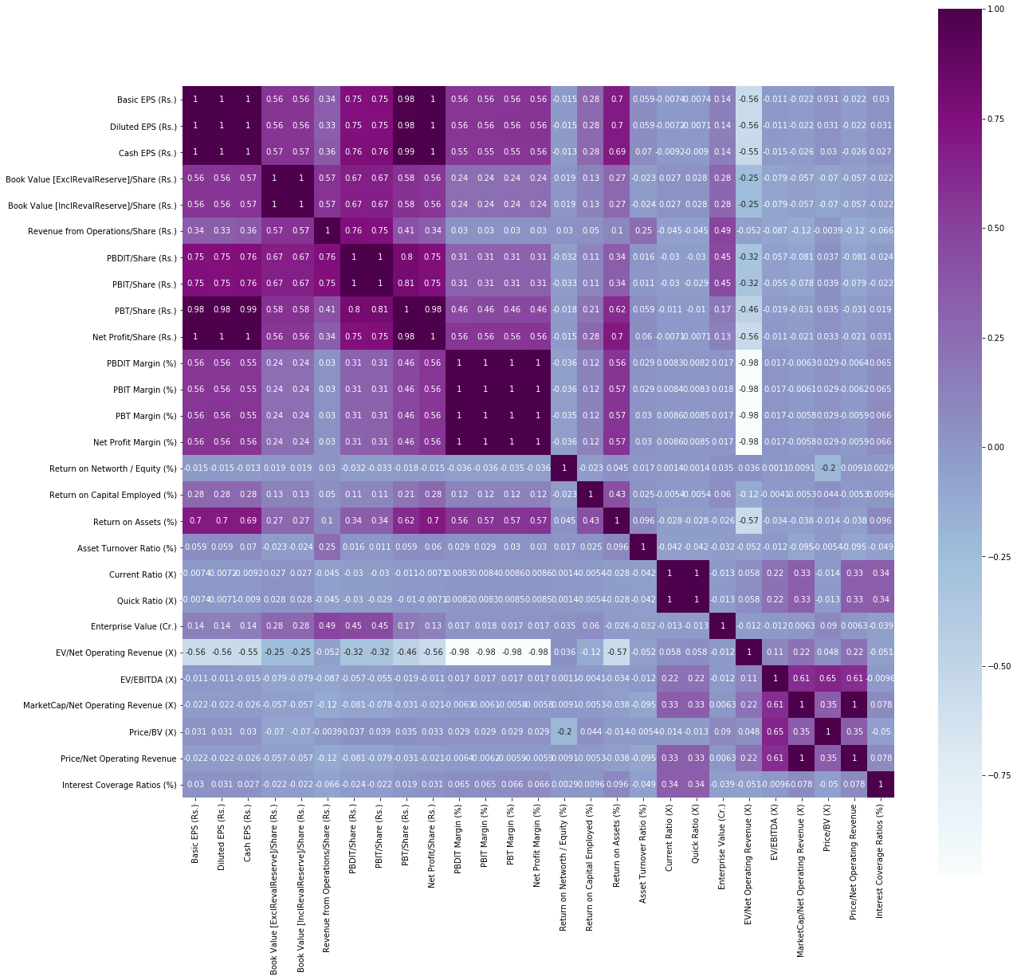
Exploratory Data Analysis Contd.
Box plot before outlier treatment and after outlier treatment
Correlation matrix for all the independent and dependent variables
Before outlier treatment
After outlier treatment
Correlation Matrix

Slide 7
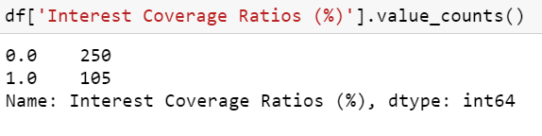
Model Building & fitting
As the first step of model building we converted the ICR into Binary values 0 (for companies with ICR > 1.5 which is considered to be good) and 1 (for companies with ICR < 1.5, considered to be bad).
ICR is the Dependent variable as it is used to determine how easily a company can pay its interest expenses on outstanding debts.
ICR Converted to categories

Slide 8
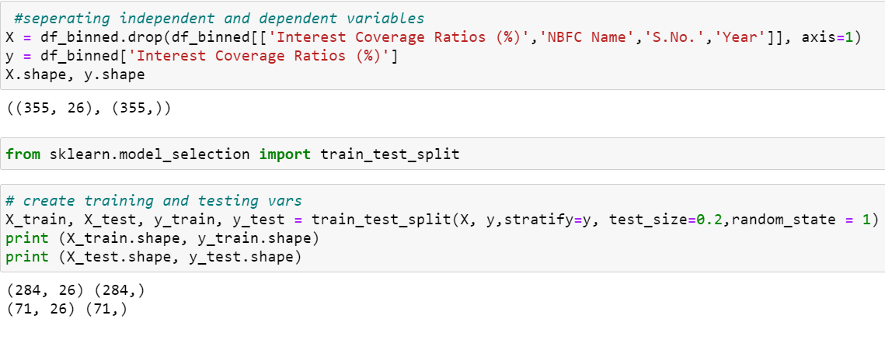
Model Building & fitting Contd.
After that we converted all the other ratios, the independent variables, into their risk ranking through Binning technique.
After binning we had split the data into train set and test set in 80-20 % using stratified random sampling, because it converts data set into homogeneous strata's
Splitting into train & test sets

Slide 9
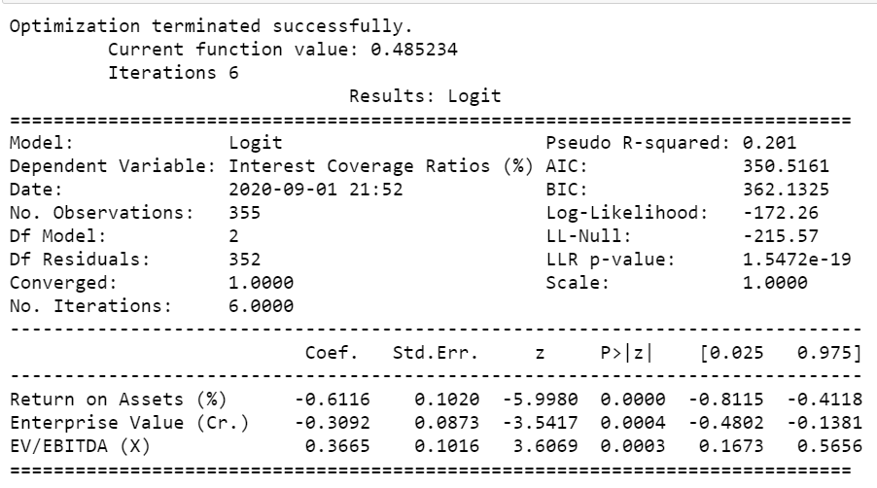
Model Building & fitting6 Contd.
Then we used Logistic Regression method to build an equation and fit the model with significant variables only ( p < 0.05).
After implementing regression we found there is insignificance due to multi-collinearity so treated it using VIF method
Logistic Regression output

Slide 10
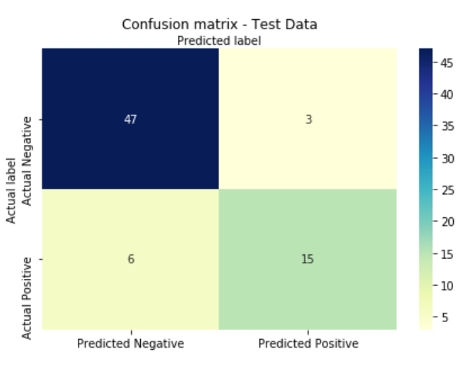
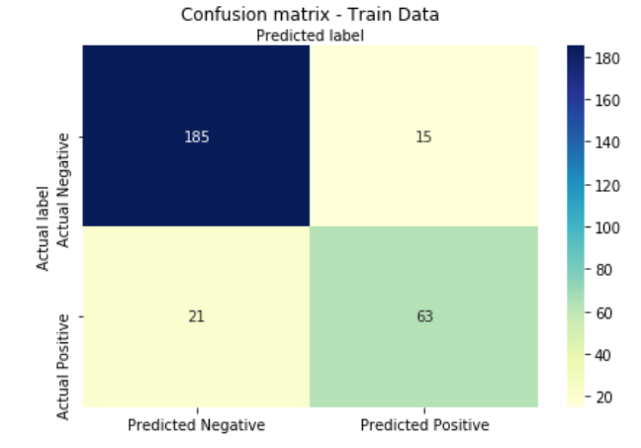
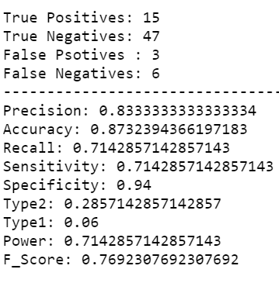
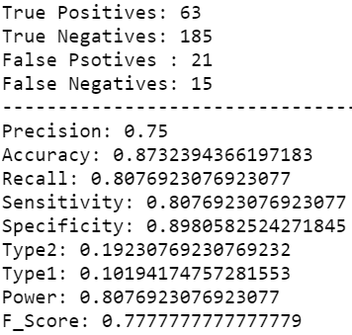
Model validation
A confusion matrix is a summary of prediction results on a classification problem.
The number of correct and incorrect predictions are summarized with count values and broken down by each class.
The classification report shows a representation of the main classification metrics on a per-class basis.
This gives a deeper intuition of the classifier behavior over global accuracy which can mask functional weaknesses in one class of a multiclass problem.
Confusion matrix Test Data
Confusion matrix Train Data
Classification report Test Data
Classification report Train Data

Slide 11
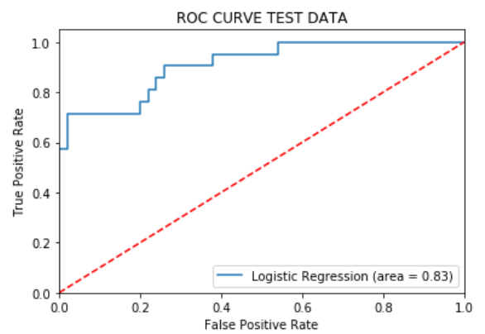
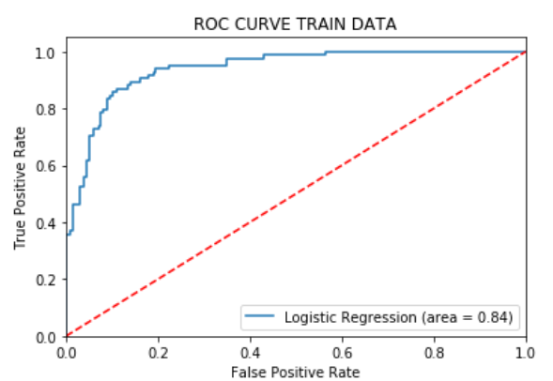


Model validation contd.
we used the ROC curve to see how much our model is capable of distinguishing between classes.
The ROC curve is plotted with TPR against the FPR where TPR is on y-axis and FPR is on the x-axis.
If AUC is near 1 good the model is at predicting and near 0.5 is not good
We also calculated Gini coefficients for both test and train sets.

Slide 12

Learnings
Data Collection
Data Cleaning
Choice of Dependent Variable (Interest Coverage Ratio)
Risk Ranking of the Independent variables
Binning
Outlier Treatment
Classification Algorithms
Model building
Model Evaluation Metrics

Slide 13

Challenges faced in execution
Binning independent variables
Outlier Treatment
Implementing stratified random sampling, recursive elimination function / stepwise regression.
Finding out Type 1, Type 2 errors
Interpretation of classification report

Slide 14
Thank You
We invite Feedback Questions and Remarks

